Slide 1

UNIT 5
FILE SYSTEM
FILE SYSTEM CONCEPTS

Slide 2
File Concept
A file is a named collection of related information that is recorded on secondary storage.
From a user’s perspective, a file is the smallest allotment of logical secondary storage; that is, data cannot be written to secondary storage unless they are within a file.
Commonly, files represent programs (both source and object forms) and data.
Types:
Data
Numeric, character, binary
Program
A file is a sequence of bits, bytes, lines, or records, the meaning of which is defined by the file’s creator and user.
Many types
text file - sequence of characters organized into lines (and possibly pages).
source file - sequence of functions, each of which is further organized as declarations followed by executable statements
executable file - series of code sections that the loader can bring into memory and execute.

Slide 3
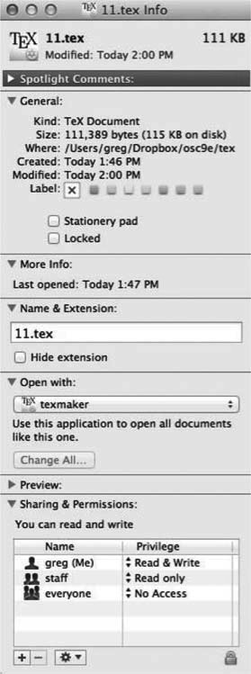
File Attributes
A file’s attributes vary from one operating system to another but typically consist of these:
Name – only information kept in human-readable form
Identifier – unique tag (number) identifies file within file system
Type – needed for systems that support different types
Location – pointer to file location on device
Size – current file size
Protection – controls who can do reading, writing, executing
Time, date, and user identification – data for protection, security, and usage monitoring
Information about files are kept in the directory structure, which is maintained on the disk
Many variations, including extended file attributes such as file checksum

Slide 4
File Operations
A file is an abstract data type. To define a file properly, we need to consider the operations that can be performed on files.
Create - space in the file system must be found for the file, an entry for the new file must be made in the directory
Write – The system must keep a write pointer to the location in the file where the next write is to take place.
Read – at read pointer location.
Reposition within file - the current-file-position pointer is repositioned to a given value. Seek operation
Delete - release all file space, so that it can be reused by other files, and erase the directory entry.
Truncate - The user may want to erase the contents of a file but keep its attributes.
Other operations – May include append, rename, copy etc.
System calls
Open(F_{i}) – search the directory structure on disk for entry F_{i}, and move the content of entry to memory
Close (F_{i}) – move the content of entry F_{i} in memory to directory structure on disk

Slide 5
Open File Operations
Several pieces of data are needed to manage open files:
Open-file table: tracks open files
File pointer: pointer to last read/write location, per process that has the file open
File-open count: counter of number of times a file is open
Disk location of the file: cache of data access information
Access rights: per-process access mode information

Slide 6
File Types
A common technique for implementing file types is to include the type as part of the file name. The name is split into two parts—a name and an extension, usually separated by a period.
The system uses the extension to indicate the type of the file and the type of operations that can be done on that file.
Only a file with a .com, .exe, or .sh extension can be executed, for instance.
Application programs also use extensions to indicate file types in which they are interested.
For example, Java compilers expect source files to have a .java extension, and
the Microsoft Word word processor expects its files to end with a .doc or .docx extension.

Slide 7
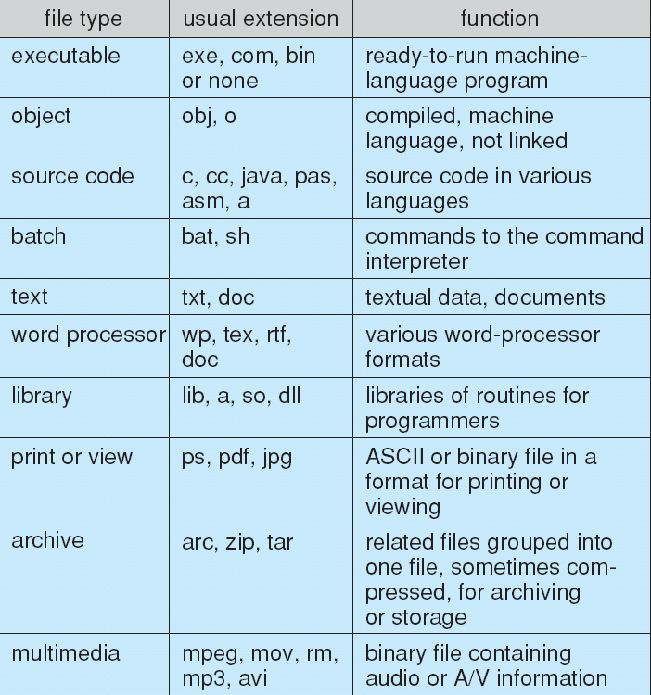
File Types

Slide 8
File Structure
File types also can be used to indicate the internal structure of the file.
Certain files must conform to a required structure that is understood by the operating system.
Simple record structure
Lines
Fixed length
Variable length
Complex Structures
Formatted document
Relocatable load file

Slide 9
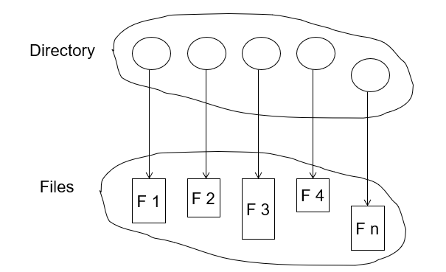
Directory
How to store files on directory?
Files are stored inside directory.
A directory is a collection of nodes containing information about all files
Both the directory structure and the files reside on disk

Slide 10
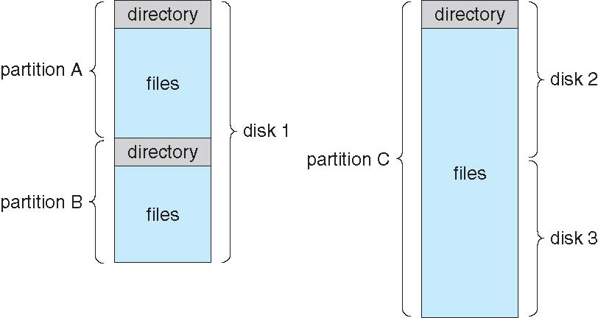
Disk Structure
Disk can be subdivided into partitions
Disk or partition can be used raw – without a file system, or formatted with a file system
Partitions also known as minidisks, slices
Entity containing file system known as a volume
Each volume containing file system also tracks that file system’s info in device directory or volume table of contents
As well as general-purpose file systems there are many special-purpose file systems, frequently all within the same operating system or computer
A typical file-system organization

Slide 11
Directory Structure
Types
Single-Level Directory
Two-Level Directory
Tree-Structured Directories
Acyclic-Graph Directories
General Graph Directory
Single Level Directory
The simplest directory structure is the single-level directory. All files are contained in the same directory, which is easy to support and understand.
A single-level directory has significant limitations, however, when the number of files increases or when the system has more than one user.
Naming problem
Grouping problem
Keeping track of so many files is a daunting task.
Since all files are in the same directory, they must have unique names

Slide 12
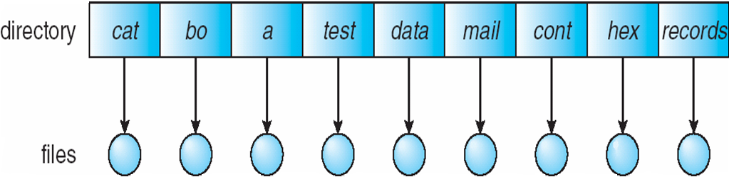
Single-Level Directory

Slide 13
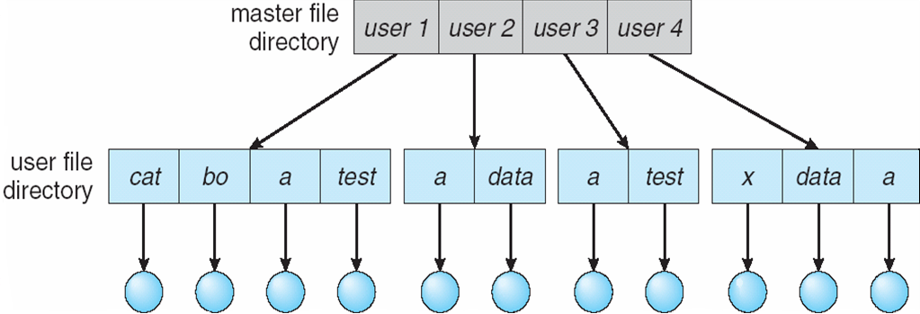
Two Level Directory
In the two-level directory structure, each user has his own user file directory (UFD). The UFDs have similar structures, but each lists only the files of a single user.
When a user job starts or a user logs in, the system’s master file directory (MFD) is searched. The MFD is indexed by user name or account number, and each entry points to the UFD for that user.
When a user refers to a particular file, only his own UFD is searched. Thus, different users may have files with the same name

Slide 14
Two Level Directory
Path name - a user name and a file name define a path name. Every file in the system has a path name. To name a file uniquely, a user must know the path name of the file desired.
For example C:\userb\test.
Can have the same file name for different user
Efficient searching
No grouping capability
Subdirectories cannot be allowed

Slide 15
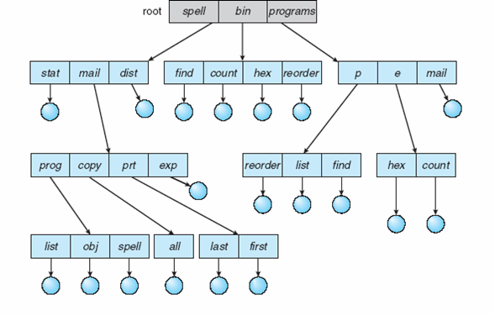
Tree-Structured Directories
Directory structure viewed as a tree of arbitrary height
Allows users to create their own subdirectories and to organize their files accordingly.
A tree is the most common directory structure. The tree has a root directory, and every file in the system has a unique path name.
One bit in each directory entry defines the entry as a file (0) or as a subdirectory (1).

Slide 16
Tree-Structured Directories
The current directory should contain most of the files that are of current interest to the process.
Path names can be of two types:
absolute and relative.
An absolute path name begins at the root and follows a path down to the specified file, giving the directory names on the path.
A relative path name defines a path from the current directory.
For example absolute path for file first in previous diagram is root/spell/mail/prt/first.
If Mail is current working directory then relative path is prt/first
Deleting
If directory is empty then it can be deleted
If not, Two approached is used
To delete all subdirectories and file to make it empty and delete. It time consuming.
Use Unix rm command to delete all file and subdirectories.
Advantages
Efficient Searching
Grouping Capability
Cannot share files

Slide 17
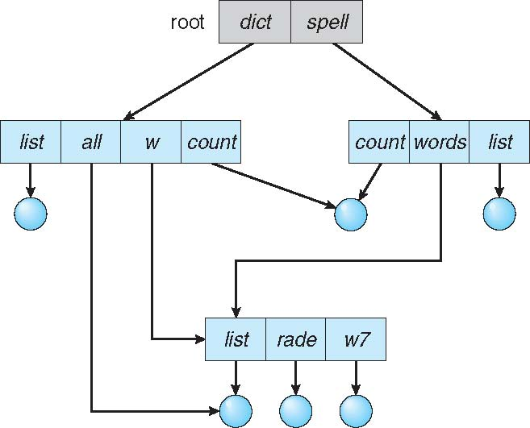
Acyclic-Graph Directories
A tree structure prohibits the sharing of files or directories.
An acyclic graph that is, a graph with no cycles—allows directories to share subdirectories and files.
The same file or subdirectory may be in two different directories. The acyclic graph is a natural generalization of the tree-structured directory scheme.
Shared files and subdirectories can be implemented by many of the UNIX systems, is to create a new directory entry called a link.
A link is a pointer to another file or subdirectory.

Slide 18
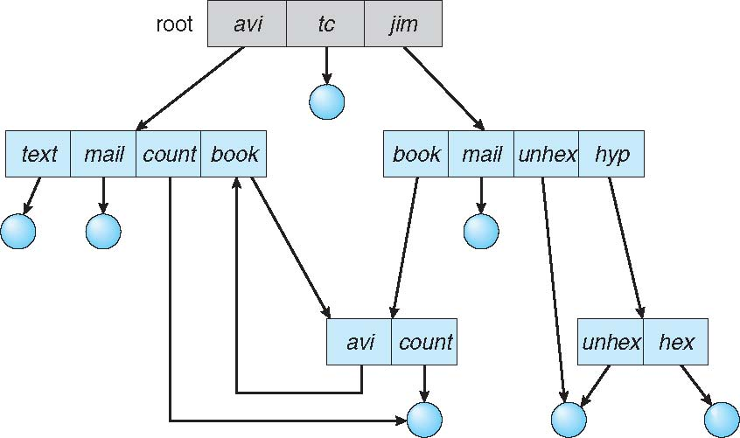
General Graph Directory
Cycles are allowed within a directory structure where multiple directories can be derived from more than one parent directory.

Slide 19


THANK YOU

